Slide 1
Distributional Tests for Supernova Searches
Sophia G. Schwalbe
Michele Zanolin, Marek Szczepanczyk, Brennan Hughey
Embry-Riddle Aeronautical University
NASA Space Grant AZ State Symposium
22 April 2016

Slide 2
Overview
Use of Distributional Tests
Examples of Distributional Tests
Current Status
Future Work

Slide 3
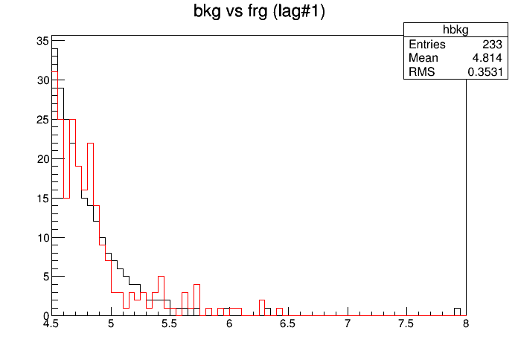
Purpose
Triggers are excess energy from detector data related to Signal-to-Noise ratio (ρ).
Two types of data:
Foreground: triggers which are gravitational wave candidates.
Background: noise triggers.
Comparison between Foreground and Background
Counts
Current detection relies on only the loudest event of foreground.
Want to use weaker events from foreground in detection.
Compare background to foreground using distributional tests.
ρ value

Slide 4
Distributional Tests
Distributional tests compare background and foreground to produce a probability that the distributions are compatible.
There are two kinds of distributional tests:
Parametric: the background distribution has a known analytical shape.
Non-parametric: no assumptions made on background shape.
In LIGO, we would like to use non-parametric tests.
With normal LIGO methods, with 3σ confidence, only 9% of events are detected
All over ρ = 8
~40% of events are lost in noise

Slide 5
Non-Parametric Distributional Tests
Need to use single scalar measure (ρ, FAR).
ρ cannot be combined between supernovae triggers with different networks.
Tests implemented so far:
Kolmogorov-Smirnov
Anderson-Darling
Mann-Whitney
Chi Squared

Slide 6
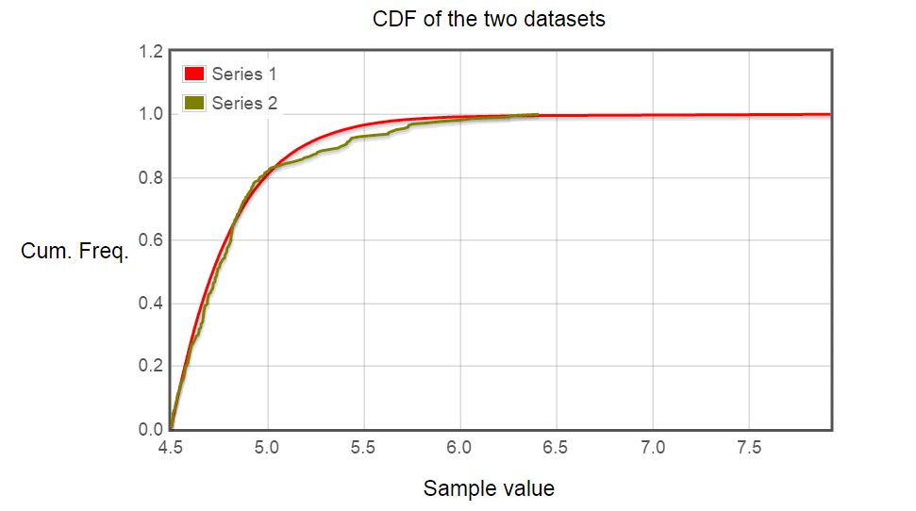
Non-Parametric Distributional Tests
Kolmogorov-Smirnov
Kolmogorov-Smirnov Theorem: if the samples come from the same population, the cumulative distributions converge
Uses continuous data
Not sensitive at extremes
Anderson-Darling
Same method as Kolmogorov-Smirnov
Different calculations for test statistic
More sensitive at extremes, less at median

Slide 7
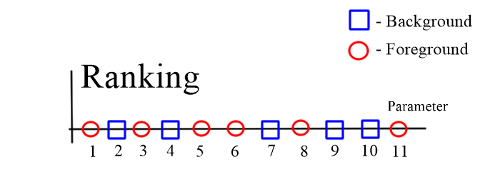
Non-Parametric Distributional Tests
Mann-Whitney
Mann-Whitney Theorem: if the samples come from the same population, the cumulative ranks will be uniformly distributed
Uses continuous data
Less powerful test compared to other non-parametric tests

Slide 8
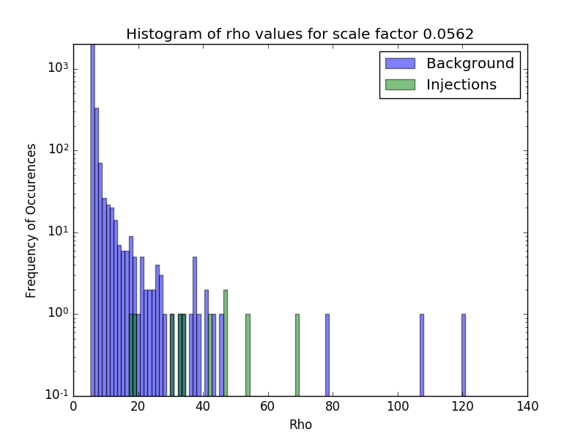
Non-Parametric Distributional Tests
Chi Squared
Chi Squared: if the samples come from the same population, the difference between bins of data will approach zero.
Uses binned data; background needs to be binned equally, foreground binned in same way

Slide 9
Background and Foreground
One Month Data
Background
Triggers
Distributional Tests
(95% confidence)
Same
Different
One Month Data
Background Triggers
Injections

Slide 10
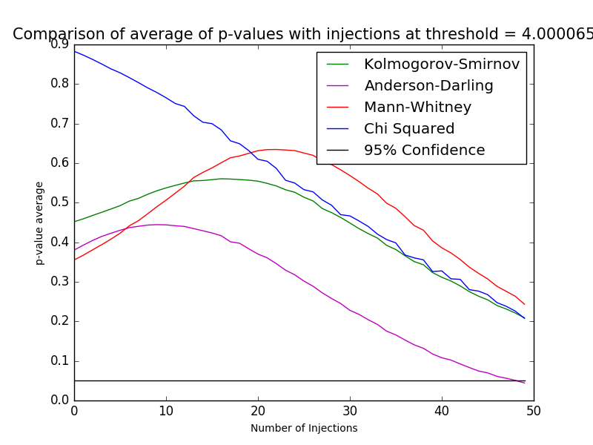
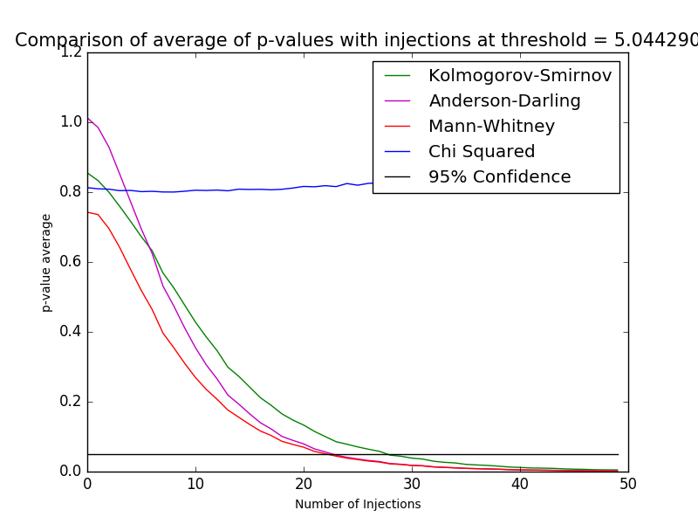
Current Status
Comparing when each test achieves sensitivity below 10 injections; comparing number in background, background type, rho thresholds, etc.
Uses S6 data with O1 sensitivity with realistic distribution of sources according to rate paper
Implementation of Chi Squared test has not improved with modification, Mann-Whitney most sensitive to changes in background
p=1
(Bkg and frg same)
Goes to p=0
(Bkg and frg different)

Slide 11
Next Steps
Will need to decide whether to use Chi Squared test
Comparing types of backgrounds for different on-source windows
Comparing different types of injections from different sources
Compare results of tests with current LIGO methods to determine benefit

Slide 12
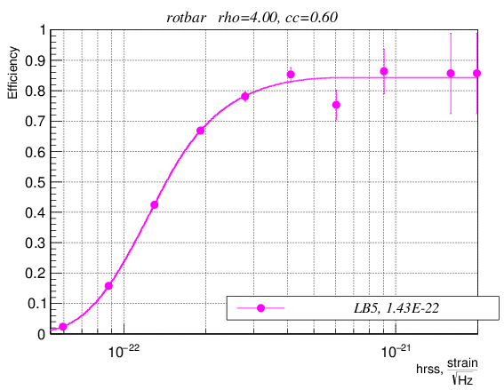
Next Steps
Compare results of tests with current LIGO methods to determine benefit
Choose a population at a certain distance away
Find how many times the distributional tests detect events
Find same fraction of detection in LIGO False Alarm Rates
Determine corresponding distance in FAR plots, compare to injected population

